Slide 1
Unit 1 Quantities & Units
Part C: Engineering Notation

Slide 2
What will you learn?
Use engineering notation to represent large and small numbers.

Slide 3
Displaying large numbers in normal form.
Take a look at these figures.
300,000,000 m/s
(Speed of light)
6,000,000,000,000,000,000,000,000 kg
(Mass of the earth)
8,700,000,000
(Estimated world population to peak by 2055)

Slide 4
Examples of Engineering Notation
300,000,000 m/s
can be expressed as 300 × 10⁶ m/s
6,000,000,000,000,000,000,000,000 kg
can be expressed as 6 × 10²⁴ kg
8,700,000,000
can be expressed as: 8.7 × 10⁹
The exponent is a multiple of 3.

Slide 5
Express a number in engineering notation:
Number y = c × 10^{3m}
where c is the coefficient, a real number
1 ≤ |c| < 1000
i.e. −1000 < c ≤ −1 or 1 ≤ c < 1000
3m is the exponent, an integer
m = ⋯ −2, −1, 0, 1, 2, 3 ⋯
3m = ⋯ −6, −3, 0, 3, 6, 9 ⋯
−1000
−1
1
10

Slide 6
Expressing the distance between Singapore and Toronto of 14,991 km in engineering notation.
1 ≤ |c| < 1000
14991 km
y = c × 10^{3m}
= 14.991 × 10³ km

Slide 7
Displaying small numbers in normal form.
0.0000254 m
(Diameter of a human hair)
0.00000043 m
(Size of a bacteria)

Slide 8
Expressing the size of bacteria “Haemophilus Influenza” of 0.00000043 m in engineering notation.
1 ≤ |c| < 1000
0.000000430m
y = c × 10^{3m}
1 2 3 4 5 6 7 8 9
3m ⇒ we may only shift the decimal point by 0, 3, 6, … places
= 430 × 10⁻⁹ m

Slide 9
Add 245.6 × 10⁶ to 8.18 × 10⁹ and express the result in engineering notation.
Two numbers to be added must have the same exponent.
You can convert either number so that both have the same exponent.
245.6 × 10⁶ = 0.2456 × 10⁹
Add the coefficients of the two numbers of same exponent.
(0.2456 + 8.18) × 10⁹ = 8.4256 × 10⁹

Slide 10
Subtract 998.84 × 10⁻⁶ from 288.12 × 10⁻³ and express the result in engineering notation.
Two numbers to be added must have the same exponent.
(288.12 × 10⁻³) − (998.84 × 10⁻⁶)
= (288.12 × 10⁻³) − (0.99884 × 10⁻³)
= (288.12 − 0.99884) × 10⁻³
= 287.12116 × 10⁻³

Slide 11
Multiply 1.25 × 10⁻⁹ and 7.02 × 10⁶ and express the result in engineering notation.
Two numbers performing multiplication do not require same exponent.
(1.25 × 10⁻⁹) × (7.02 × 10⁶)
= (1.25 × 7.02) × 10⁻⁹⁺⁶
= 8.775 X 10⁻³

Slide 12
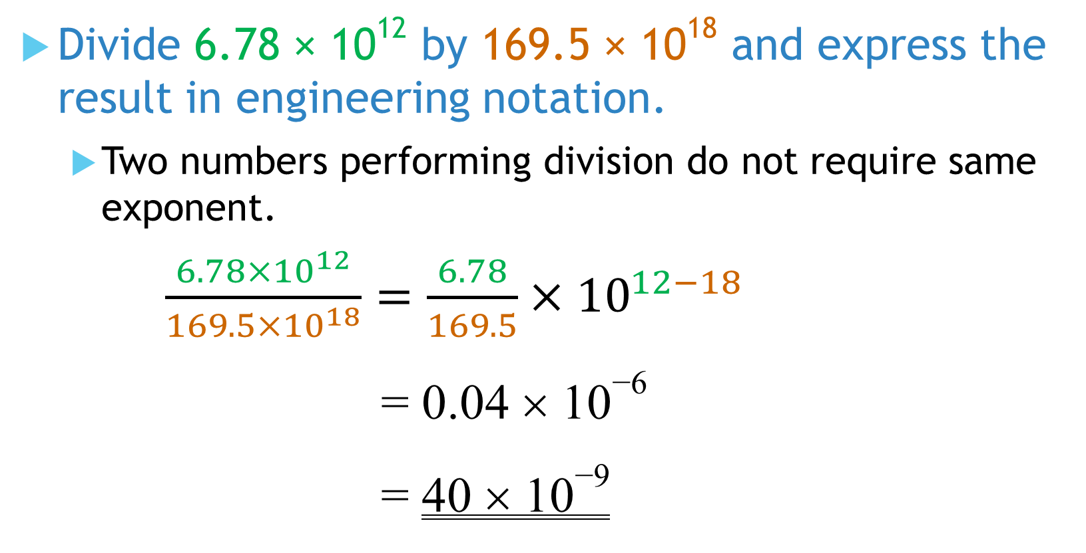
Divide 6.78 × 10¹² by 169.5 × 10¹⁸ and express the result in engineering notation.
Two numbers performing division do not require same exponent.
$\frac{6.78×{10}^{12}}{169.5×{10}^{18}}=\frac{6.78}{169.5}×{10}^{12−18}$
= 0.04 × 10⁻⁶
= 40 × 10⁻⁹

Slide 13
You have learned to
represent large and small numbers in engineering notation, c ×10^{3m},
coefficient c is in the range of 1 ≤ |c| < 1000,
exponent 3m is a multiple of 3, (m can be any integer),
performing arithmetic operations in engineering notation.

Slide 14
Coming Up Next
Metric Prefixes

